Slide 1

HISTOGRAM EQUALIZATION
Team Details
M.AKSHAYA - 22H51A04M4 B.YUKTA - 22H51A04K9
K.HARISH KUMAR - 22H51A04N4

Slide 2
contents
INTRODUCTION
NEED OF HISTOGRAM EQUALIZATION
PROGRAM
OUTPUTS
APPLICATIONS
CONCLUSION

Slide 3
Introduction to Histogram Equalization:
Histogram Equalization is a fundamental image processing technique used to improve the contrast of an image.
The main idea is to redistribute the intensity values (pixel brightness levels) so that they spread more uniformly across the entire range.
This makes the details in both dark and bright areas more visible.
Notes:
Image source: https://user-images.githubusercontent.com

Slide 4
Need Of Histogram Equalization:
In many images, especially those captured under poor lighting conditions, pixel values may cluster in a narrow range. This leads to:
Low contrast
Loss of detail in shadows or highlights
Poor visual quality
Histogram equalization helps solve these problems by enhancing the contrast.
Notes:
Image source: https://4.bp.blogspot.com

Slide 5
Program:-
clc; clear all: close all; I=imread(‘pout.tif’); %reads the image subplot(2, 2, 1); imshow(I); %displays original image title(‘Original image’);
Subplot(2, 2, 2); imhist(1, 64); %displays histogram of original image
Notes:
Image source: https://cdn.slidesharecdn.com

Slide 6
Program:-
title(‘histogram of original image’)
J=histeg(I); %histogram equalization
subplot(2, 2, 3); title(‘equalized image’) imshow(J); % displays histogramequalized image subplot(2, 2,4); imhist(J, 64); %displays histogram of equalized image title(‘histogram of equalized image’)
Notes:
Image source: https://cdn.numerade.com

Slide 7
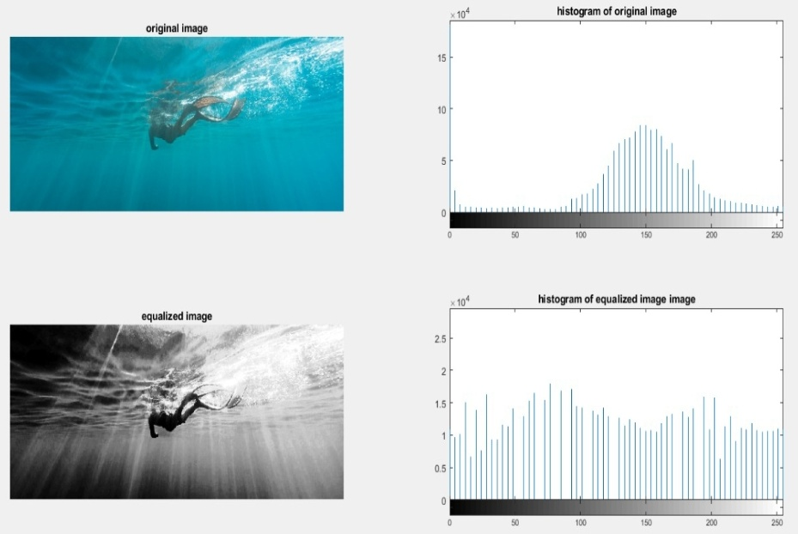
Outputs:-

Slide 8
Applications
Medical Imaging: Enhances contrast in X-rays, MRIs, and CT scans to better visualize structures and abnormalities.
Photography and Cinematography: Used to correct lighting issues and bring out details in underexposed or overexposed photographs.
Satellite and Aerial Imaging: Improves visibility of geographical features in satellite photos and remote sensing.
Notes:
Image source: https://www.mdpi.com

Slide 9
Conclusion
Histogram equalization is a widely used technique in image processing that significantly enhances image contrast by redistributing pixel intensity values. It is especially effective for improving visibility in low-contrast images, making it valuable in fields like medical imaging, satellite photography, and machine vision. While the method is simple and computationally efficient, it may sometimes lead to over-enhancement or unnatural appearance.
Notes:
Image source: https://www.slidemake.com

Slide 10


